Slide 1
ENSE 496ab Milestone 6
MudsnakeFC
Zain Chowdhary, Connor Meredith, Demitri Kourles, Xiaojie Chen, Jinpeng Chen, Shuaihao Zhao
Dec. 6, 2018

Slide 2
Team Introduction
Team Members
Zain Chowdhary, Connor Meredith, Demitri Kourles, Jinpeng Chen, Xiaojie Chen, Shuaihao Zhao
Team name
Mudsnake FC

Slide 3
Usability Evaluation Results
Visualize & discuss results from the usability evaluation at eHealth Saskatchewan
Pre-Task results
Task Results
Post-Task results

Slide 4
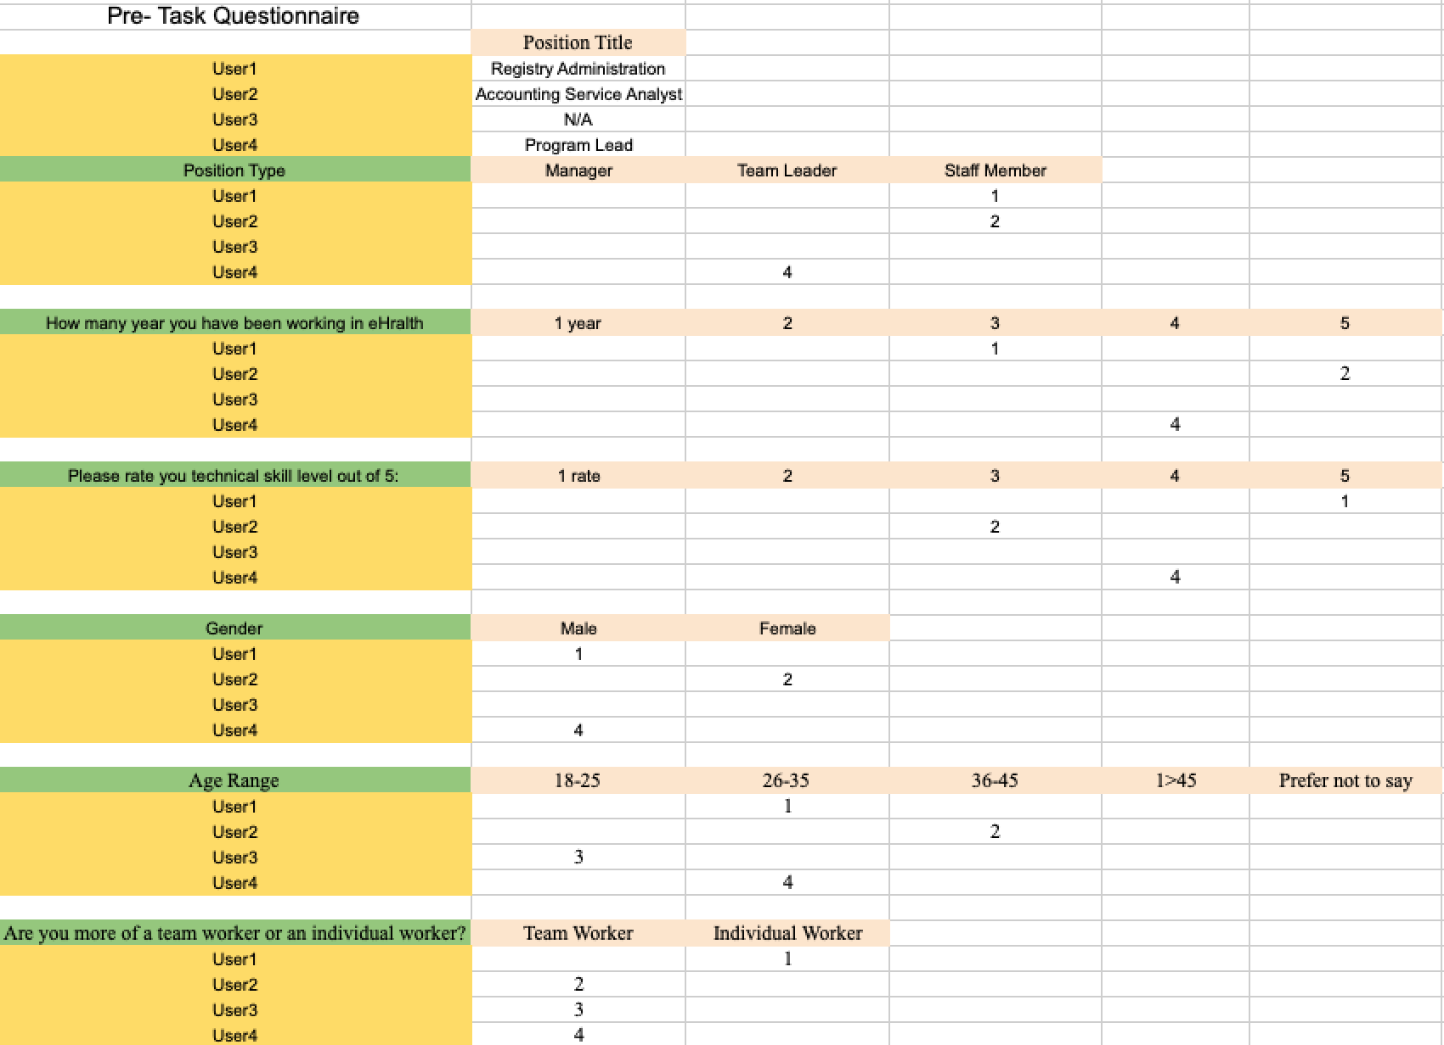
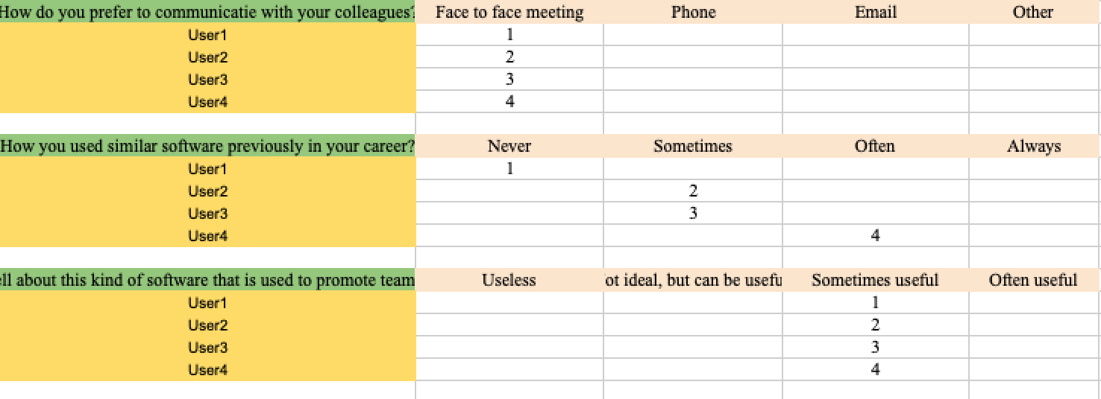

Slide 5
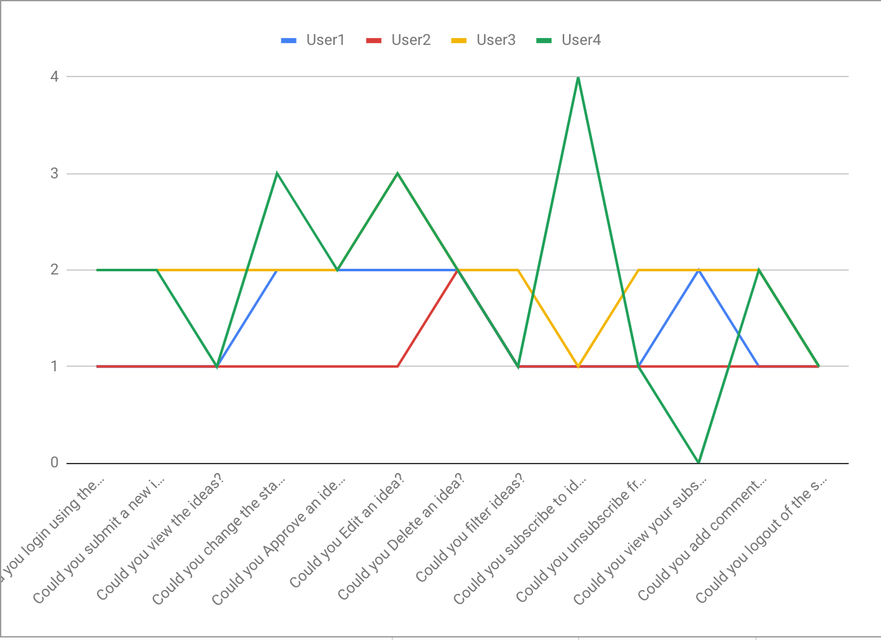
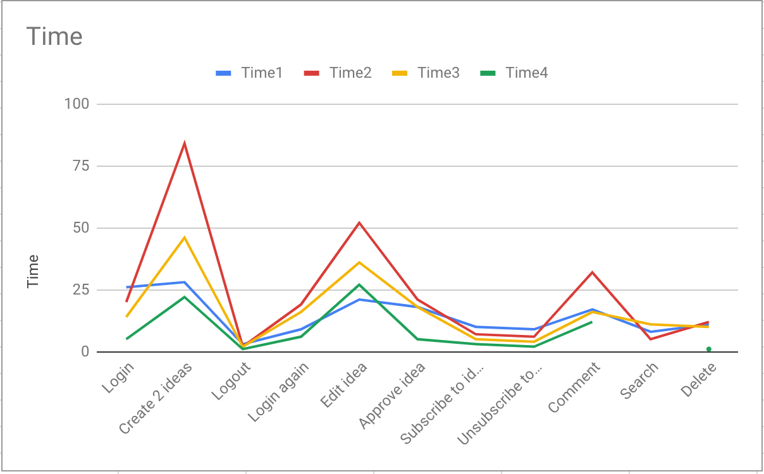

Slide 6
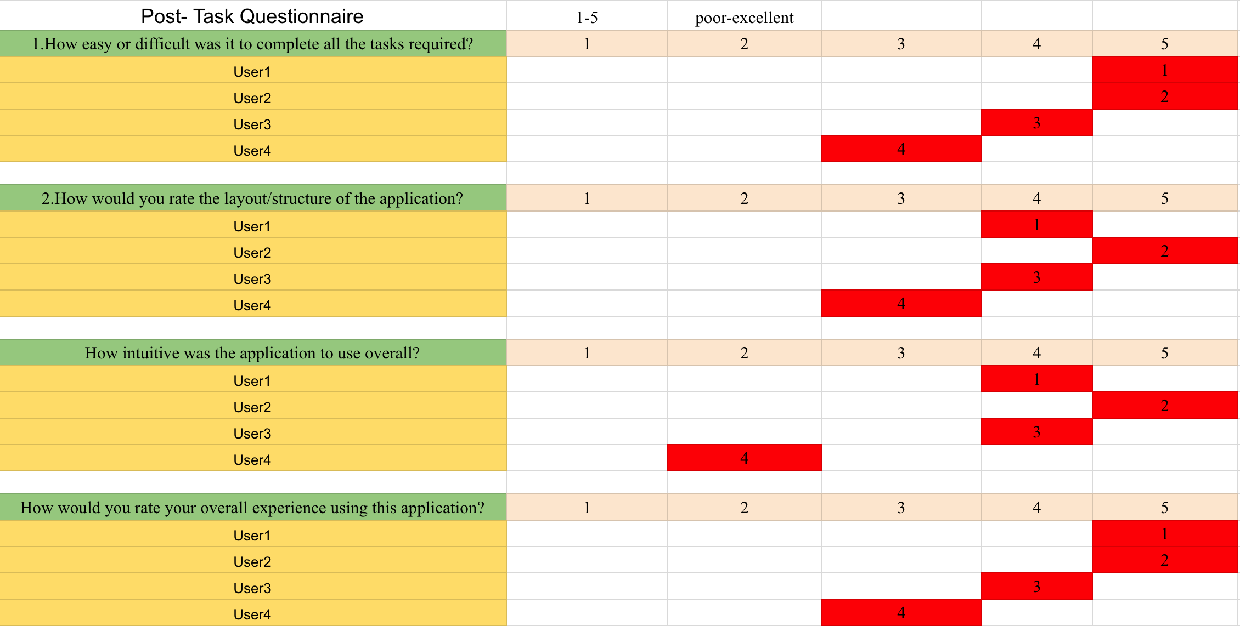

Slide 7
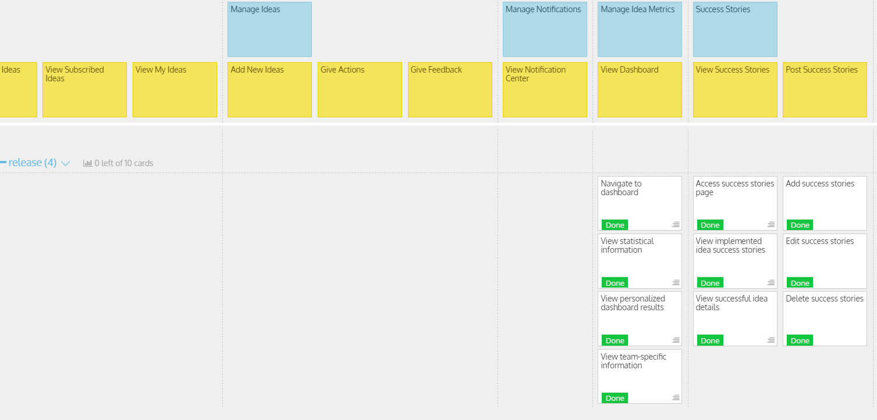
USM Review

Slide 8
USM Review
What was envisioned?
Add idea metrics
Post and view success stories
Did things stay the same or change?
Stayed the same
Rationalize your MVP
This was the last set of features from our USM. These features were added as potential points of interest for users without being essential
Rationalize with usability results
Our results show that there were no real choke points and users got the hang of the UI reasonably quick. Knowing this, we decided to focus on adding more depth to our application

Slide 9
USM Review
Discuss time management?
Met after class to delegate roles
Discuss each members roles and responsibilities
Connor
Dashboard development, coding final features, bug fixes/refactoring
Zain
Presentation, bug fixes/refactoring
Demitri
Organize Github
Nate
Usability Evaluation result
Jin
Application user guide documentation.
Hao
Success stories board development, redesign tables on database

Slide 10

MVP/Sprint-4 Demo

Slide 11
Self-evaluation of App and Development Process
Things we did well
Core functionality
DB normalization
Simple and intuitive design
Effectively utilized libraries, plugins, and other frameworks
Things that we wish we would have done differently
Use BS4 instead of BS3
Keep separation of concerns design principle in mind when delegating development tasks
Host database rather than using local DB
Allow users to preview things such as ideas and notifications
Use more controllers

Slide 12
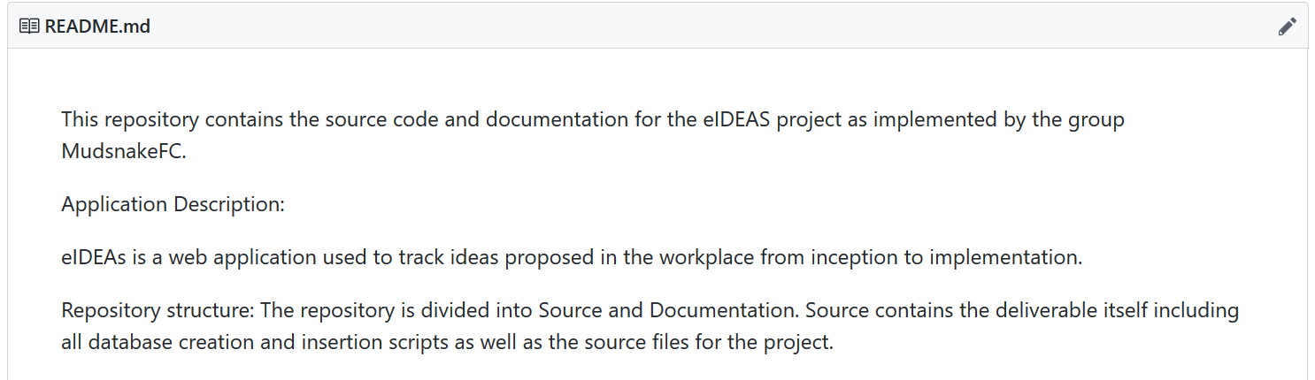
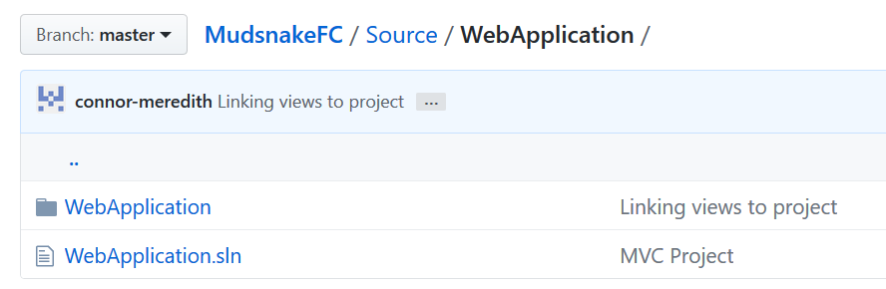
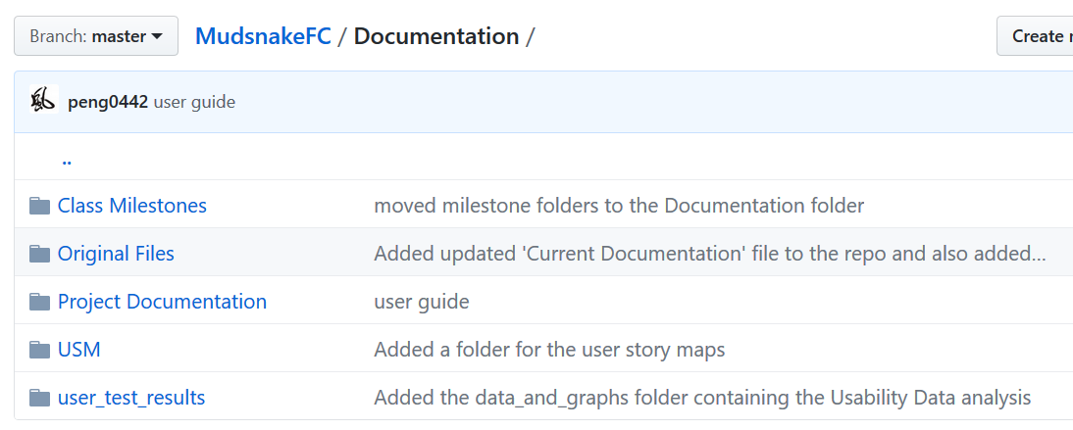
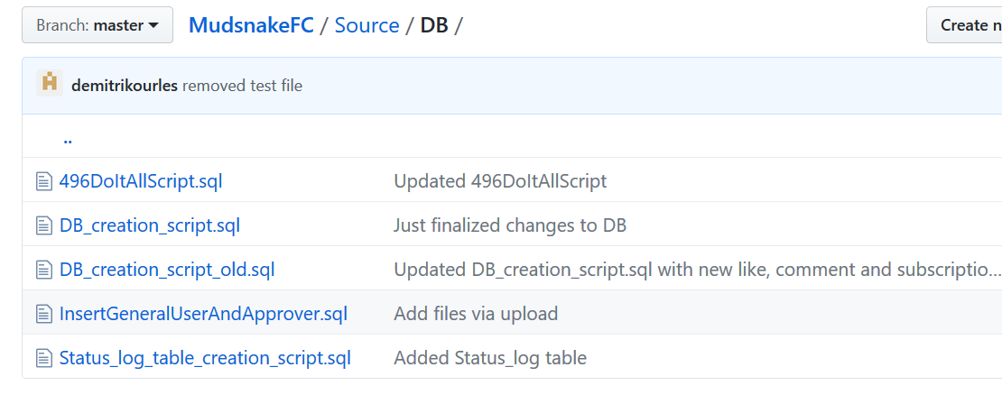
GitHub

Slide 13
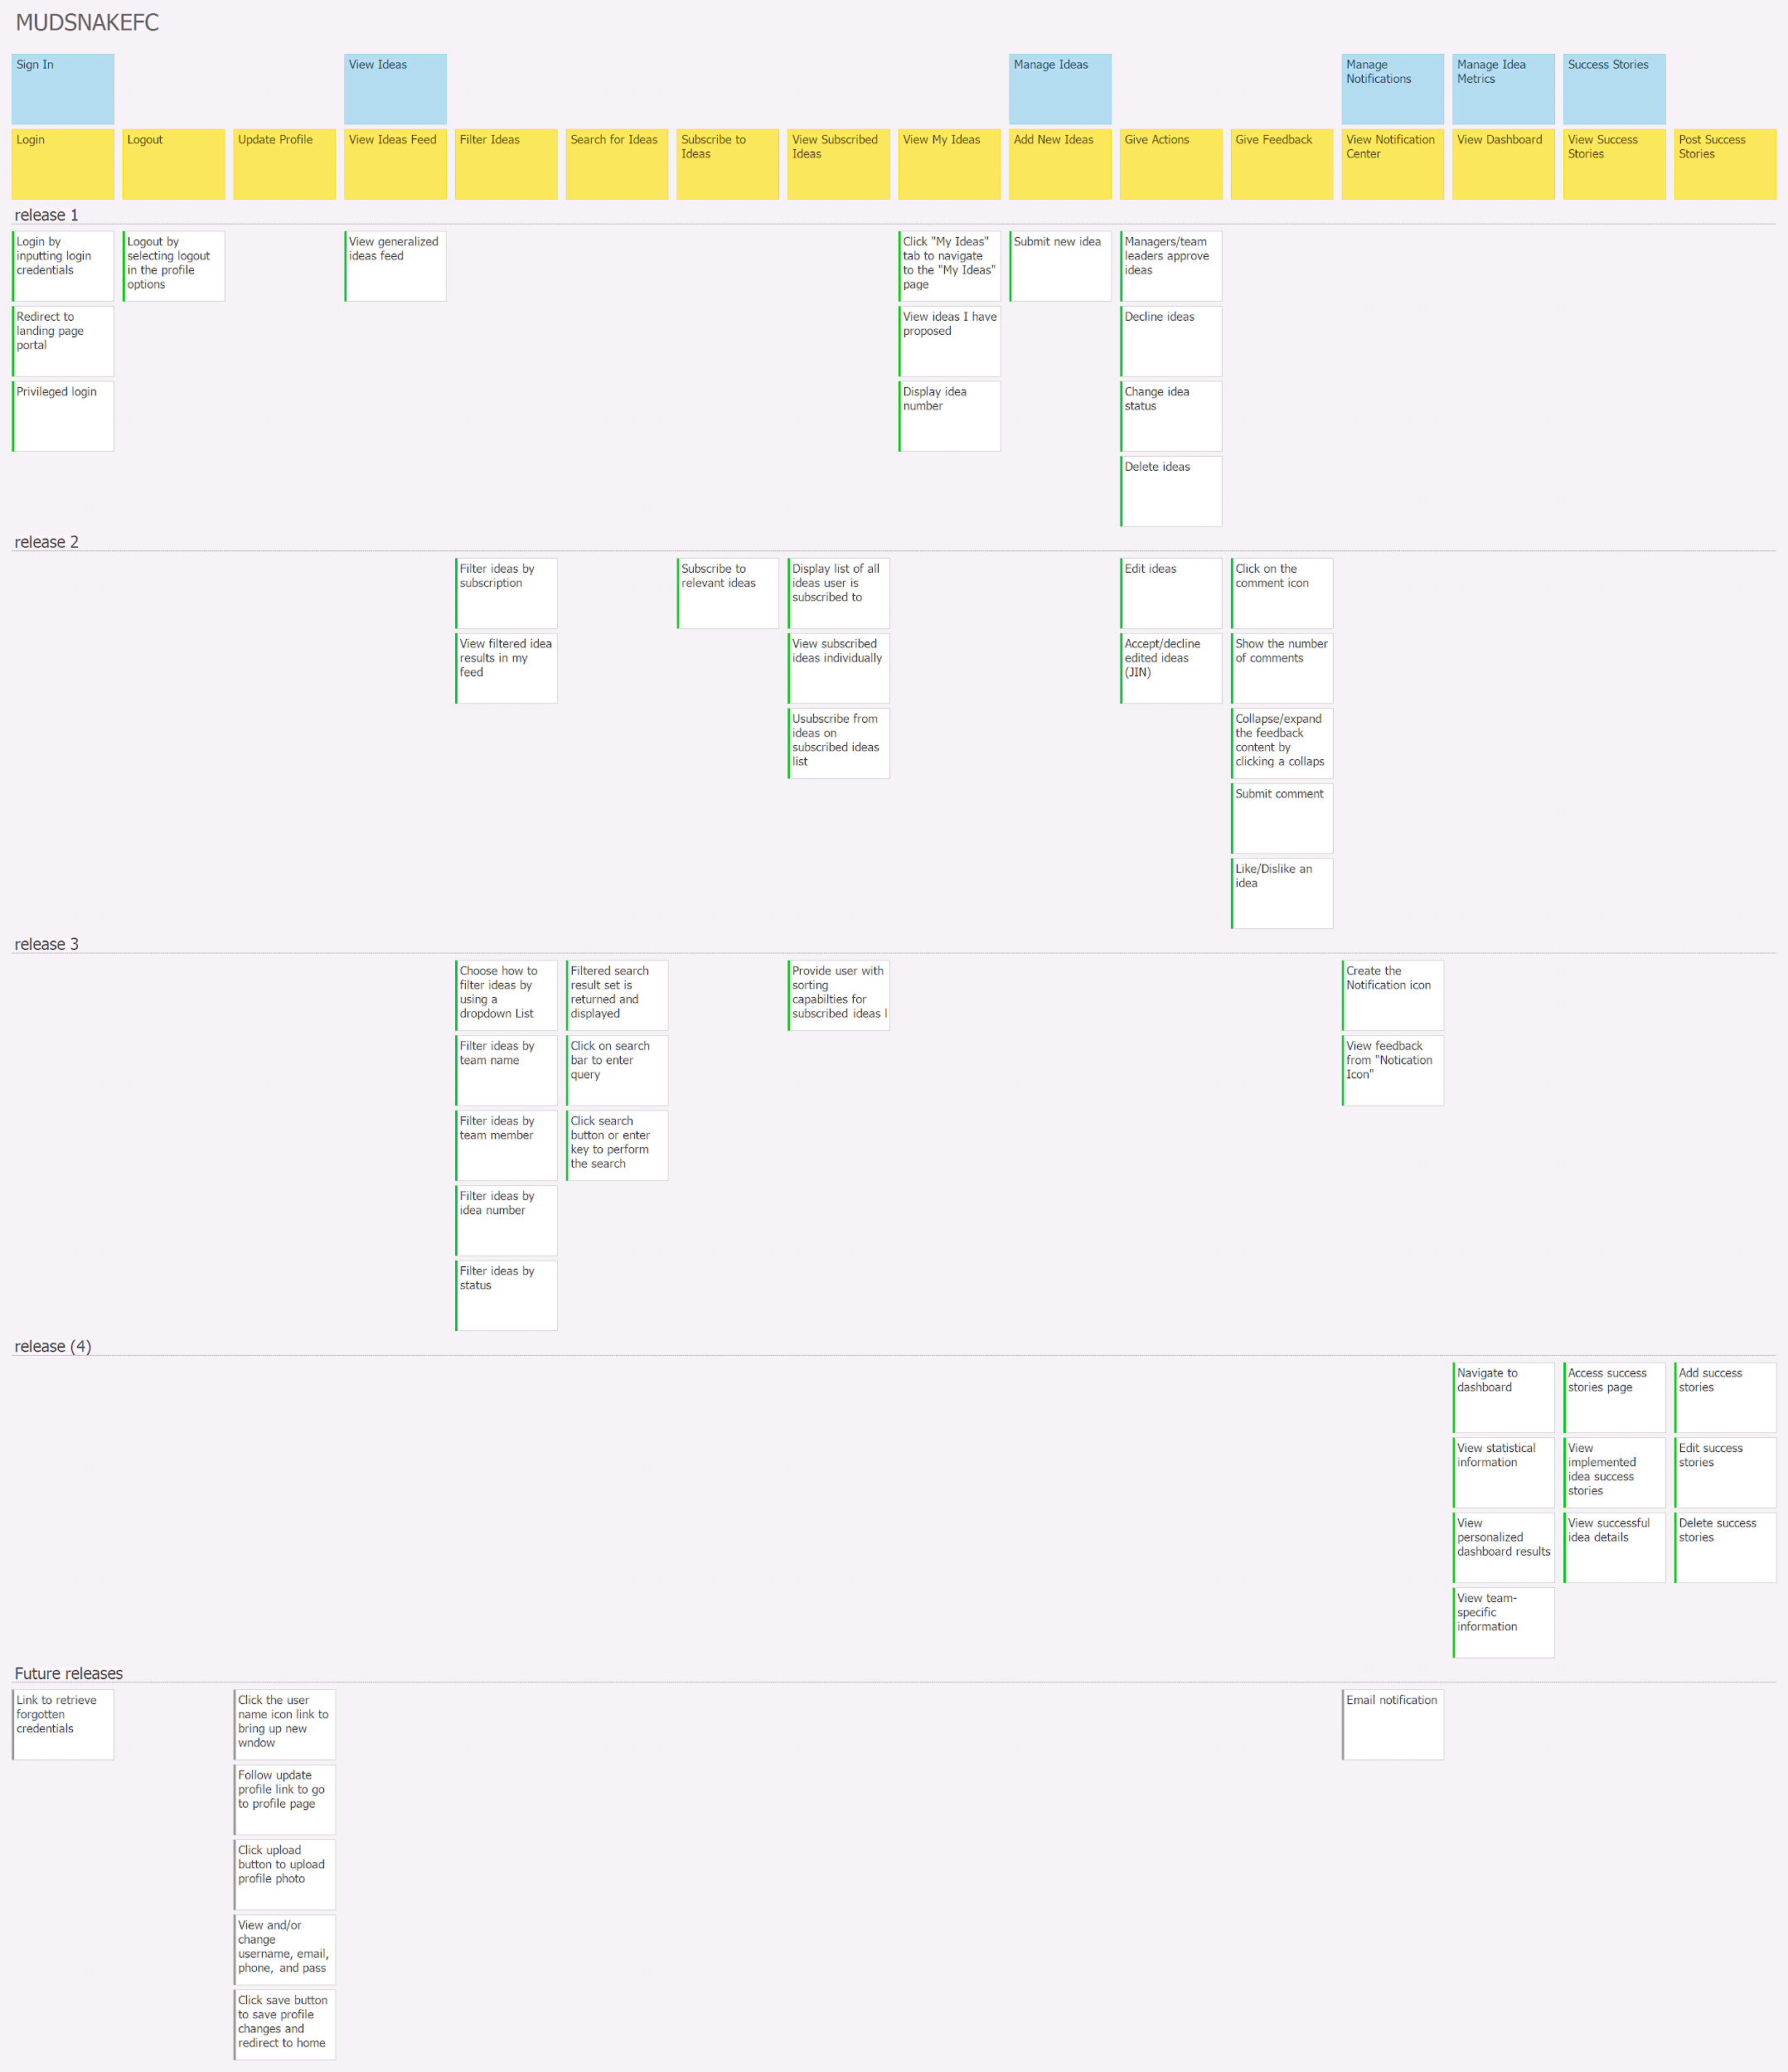
User Story Map- Releases 1 and 2

Slide 14
User Story Map- Releases 3 and 4

Slide 15
User Story Map- Future Releases

Slide 16

User Manual

Slide 17
Next Steps, Comments/Discussion
Was there anything you planned to do that didn’t get done?
Email notifications
Update profile
What do you envision next steps to be?
Refactor as necessary
Add additional features
Improve the UI

Slide 18
Group Reflection
How did you feel about this project? What did you like about it? What did you dislike? (i.e. what was good? …what was better if…?)
It was definitely worthwhile to work on a larger course project rather than have individual assignments. It was an effective way to get better with ASP.NET. We liked the concept of building MVPs for each release, as this pushed to having a well organized release plan, Using a USM helped us to stay on track and collaborate more effectively.
What did you learn about yourself as you collaborated and worked through this project?
Everybody has different skill sets. Delegation of tasks is crucial to the groups success. As long as all team members are familiar with their roles and responsibilities, we can be confident in producing a final product

Slide 19
Group Reflection
How will you use what you have learned going forward?
The whole experience of going through the software development life cycle is likely to be relevant to a lot of our careers
The technical knowledge gained is also valuable considering the widespread usage of C# and ASP.net.
What “stuff & things” related to this project would you think future students would want/need more help with?
A technical introduction to ASP.NET could help students who are not familiar with it at the start
More creative freedom may be desired

Slide 20
Questions?

